Slide 1
Machine Learning Operations MLOps and Workflow
Module 2

Slide 2
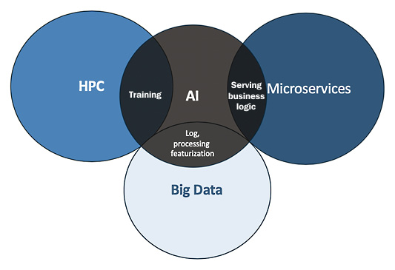
Machine Learning Operations MLOps and Workflow
Current trends show that virtually every application is starting to use AI, and these applications are running separately on distributed workloads such as High-Performance Computing (HPC), microservices technologies , and big data.
With the overlapping of big data and AI, we can leverage extracting required data at scale for AI model training, and with the overlap of microservices and AI we can serve the AI models for inference to enhance business operations and impact.
Applications running on distributed workloads

Slide 3
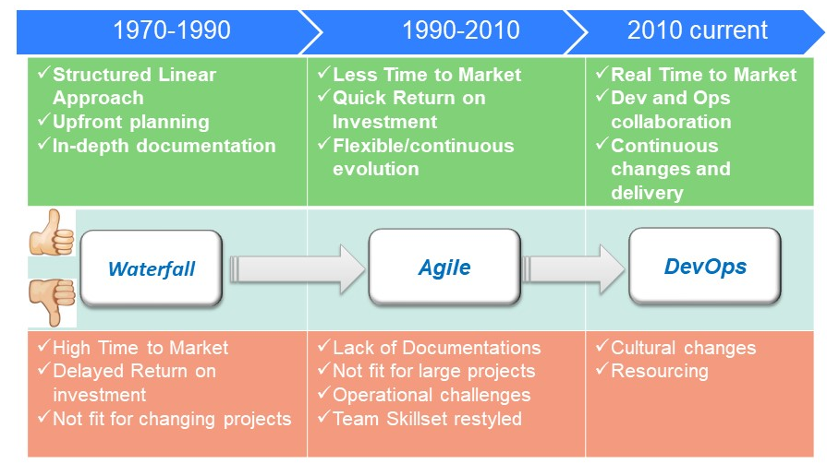
Software development evolution:
Traditionally, software development started with the waterfall method, where development is done linearly by gathering requirements to design, develop, test and deploy.
Over the years the Waterfall model evolved to Agile methodologies and the DevOps method.

Slide 4
The Development Operations (DevOps) method:
The DevOps method extend software development across the build, test, deploy, and delivery stages.
It promotes software developers and IT operators to collaborate, integrate, and automate in order to improve the efficiency, speed, and quality of providing customer-centric software.
DevOps is a software development methodology that streamlines the process of building, testing, delivering, and monitoring systems in production.
DevOps has made it possible to release software to production in minutes and maintain it consistently.

Slide 5
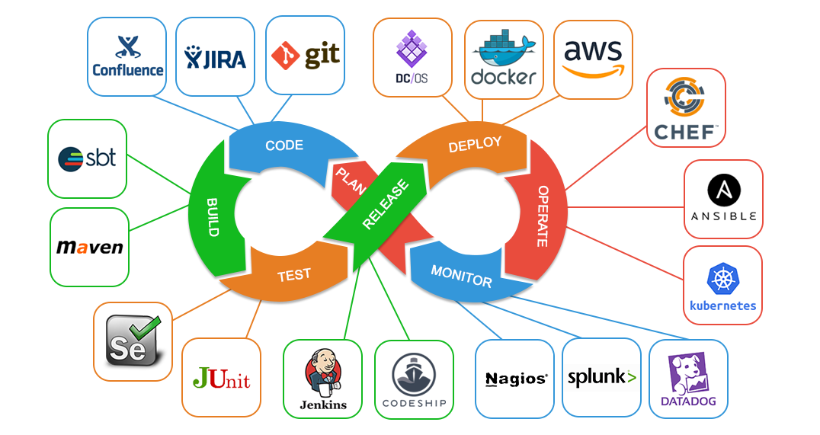
The DevOps methods such as continuous integration, continuous deployment, and continuous delivery are all key parts of DevOps
Some of the key tools and technologies used to streamline DevOps

Slide 6
Despite the success of DevOps and Agile software development methodologies, but still cannot use the same methods for machine learning (ML) applications.
The reason is ML is not just code, it is code + data. Data for training, testing, and inference will change over time, across different sources, and needs to be met with changing code.
Without a systematic MLOps approach, there can be divergence in how code and data evolve.
This can cause problems in production, and deployment leading to results that are hard to trace or reproduce
MLOps streamlines the development, deployment, and monitoring pipeline for ML applications

Slide 7
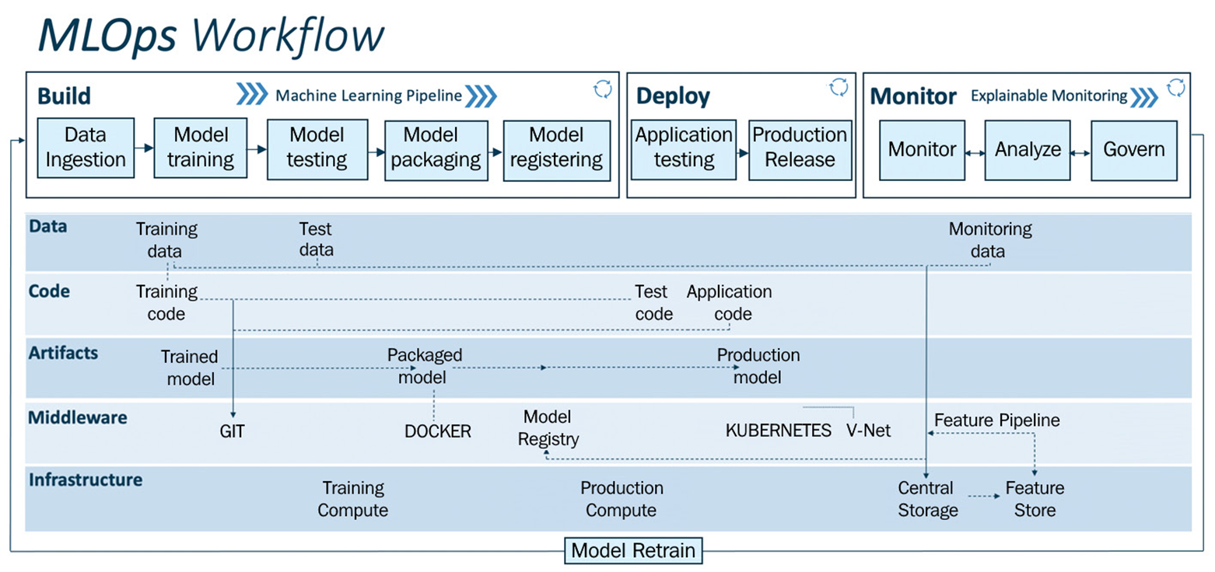
Machine Learning Lifecycle: MLOps Workflow
The figure below operationalizes the ML lifecycle in a three-stage MLOps workflow of Build, Deploy, and Monitor
The Build stage encompasses the many of the initial stages of the ML lifecycle examined earlier: problem definition, Data collection/labeling, Data Evaluation, Feature Engineering, Model training and Evaluation.
The Deploy stage is where the model is deployed in production as an API
The Monitor stage is where the ML operation is monitored for optimal performance and accuracy
A sample MLOps Workflow

Slide 8
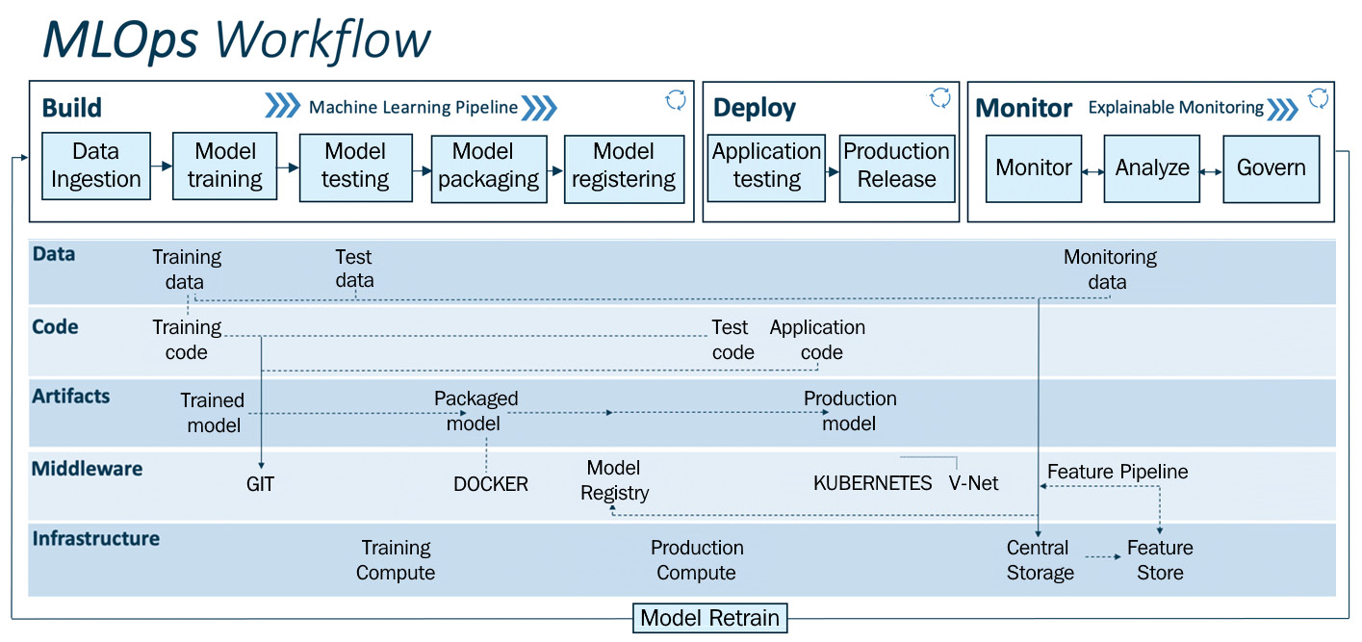
A sample MLOps Workflow
A generic MLOps workflow brings together data engineering, ML, and DevOps in a streamlined fashion. This workflow is segmented into two modules:
MLOps pipeline (build, deploy, and monitor) – the upper layer
Drivers: Data, code, artifacts, middleware, and infrastructure – mid and lower layers

Slide 9

The MLOps pipeline – Build: The MLOps pipeline is the upper layer of the workflow, which performs operations such as build, deploy, and monitor
The Build stage encompasses the first six stages of ML lifecycle, namely: problem definition, data preparations, data explorations, data transformation and selection, model training and validations as discussed earlier
Data ingestion: Deals with the volume, velocity, veracity, and variety of data by extracting data from various data sources (for example, databases, data warehouses, or data lakes)
Data ingestion is the transportation of data from assorted sources to a storage medium where it can be accessed, used, and analyzed by an organization. The destination is typically a data warehouse, data mart, database, or a document store. This step performs the extraction, transformation, and load (ETL) operations to provide the necessary data for ML training purposes.

Slide 10
ETL (Extract, Transform and Load) is another holistic term used in Machine Learning that encompasses data ingestion, cleaning and loading. The term is often used to synthesize data for long-term use into data warehouses or data lake structures optimized for analytics
Data ingestion is a broader term covering any process of adapting incoming data into required formats, structures and quality, while ETL is traditionally more used in conjunction with data warehousing and data lakes.
Data transformation is also performed during ETL. Feature scaling and label encoding are among common data transformations.
In label encoding, a categorical feature values like( male, female) is encoded into numeric values ( 0, 1).
Data cleaning and transformation are done to improve the quality of data and prepare it for further analysis and model training.
The data is split and versioned for model training, for example, the training and test set. As a result of this step, any model training can be audited and is back-traceable

Slide 11
The MLOps pipeline – Build: Model training: In this step the feature engineering, feature selection and model training is performed.
This step involves identifying the right drivers/features that affect the target variable and also engineering or deriving the new features based on existing features.
The MLOps pipeline – Build: Model training: The model training step is the process of developing a model that best describes the relationship between independent and dependent variables. Various ML models are to be built based on the problem statement.

Slide 12
Once the model is trained, its performance can be improved by hyperparameter tuning activities. Hyperparameter tuning is performed by applied methods such as Grid Search or Random Search.
Hyperparameter tuning is conducted after model evaluation to improve performance of the model

Slide 13
The MLOps pipeline – Build: Model Testing/Packaging/Registering
Model testing: The trained model performance is evaluated on a test data (which was split and versioned in the data ingestion step). The inference of the trained model is evaluated according to selected metrics as per the use case. The output of this step is a report on the trained model's performance.
Model packaging: After the trained model has been tested, it can then be serialized into a file or containerized (using Docker) to be exported to the production environment.
Model registering: The serialized or containerized model is registered and stored in the model registry.
A registered model is a logical collection or package of one or more files that assemble, represent, and execute your ML model.
Multiple files such as parameter weights, and serialized model files can be registered as one model. After registering, the model (all files or a single file) can be downloaded and deployed as needed.

Slide 14
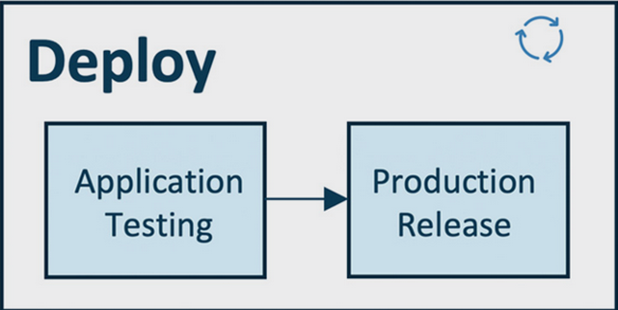
The MLOps pipeline – Deploy: This is the step to operationalizing the ML. The deploy pipeline has two components – production ( or production like environment) testing and production release
Deployment pipeline is enabled by streamlined CI/CD pipelines connecting the development to production environments.

Slide 15
The MLOps pipeline – Deploy: Application testing: Before deploying an ML model to production, it is vital to test its robustness and performance via testing
Deploy the models in the test environment (pre-production), which replicates the production environment.
Deploy model as an API or streaming service in the test environment to deployment targets such as Kubernetes clusters, container instances, or scalable virtual machines or edge devices as needed.
Perform predictions using test data (sample data from a production environment). Model inference is done in batch or periodically to test for robustness and performance.
When the ML model's performance meets the standards, then it is approved to be deployed in the production environment

Slide 16
The MLOps pipeline – Deploy: Production release
The MLOps pipeline – Deploy: Production release: The tested and approved models are deployed in the production environment for model inference to generate business or operational value. This production release is deployed to the production environment enabled by CI/CD pipelines.

Slide 17
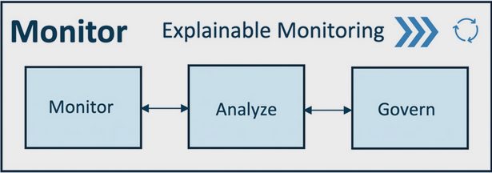
The MLOps pipeline - Monitor: Captures information to monitor data integrity, model drift, and application performance.
Model drift is the degradation of model performance due to changes in data and relationships between input and output variables
Analyze: Analyze model performance by evaluating important aspects such as model fairness, trust, bias, transparency, and error analysis with the intention of improving the model in correlation to business requirements.

Slide 18
Govern: After monitoring and analyzing the production data, we can generate certain alerts and actions to govern the system. For example, the quality assurance expert gets alerted when model performance deteriorates (for example, low accuracy, high bias, and so on)
An important aspect of governance is "compliance" with the local and global laws and rules. Model auditing and reporting are done to provide end-to-end traceability.

Slide 19
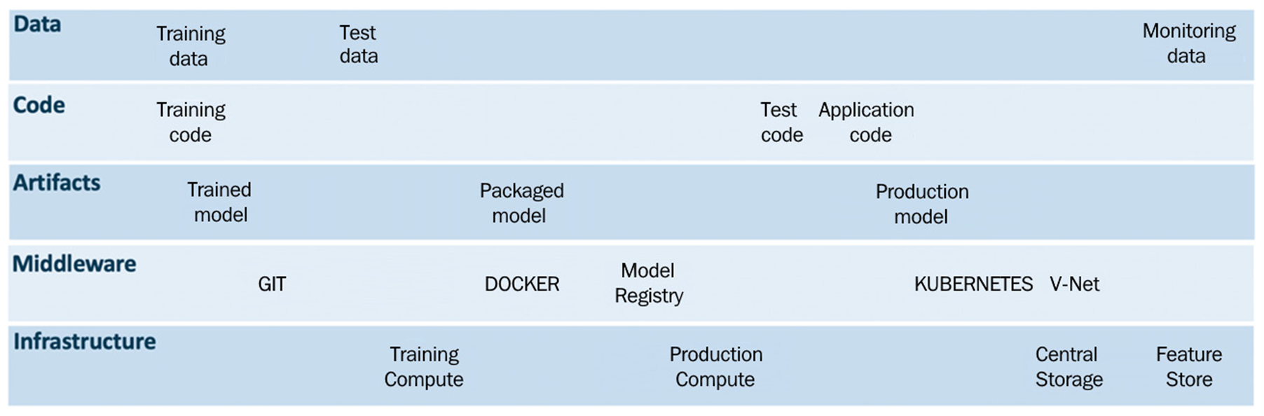
The MLOps pipeline- Drivers: The key derivers in MLOps pipeline are data, code, artifacts, middleware, and infrastructure.
Data: Data can be in text, audio, video, or images. In ML data can be structured or unstructured. Data is handled in series of steps then it is segmented and versioned into training data, testing data, and monitoring data (collected in production, for example, model inputs, outputs, and telemetry data). These data operations are part of the MLOps pipeline.

Slide 20
The MLOps pipeline- Drivers- Code: There are three essential modules of code that drive the MLOps pipeline: training code, testing code, and application code. These scripts or code are executed using the CI/CD and data pipelines to ensure the robust working of the MLOps pipeline.
The source code management/repository system such as Git will enable orchestration and play a vital role in managing and integrating seamlessly with CI, CD, and data pipelines. All the code is staged and versioned in the source code management setup, like Git).

Slide 21
Artifacts: The artifacts such as data, serialized models, code snippets, system logs, ML model training, and testing metrics information are useful for the successful working of the MLOps as well as its traceability and sustainability.
These artifacts are managed using middleware services such as the model registry, workspaces, logging services, source code management services, databases, and so on.
Middleware: There are a diverse set of middleware software and services depending on the use cases, for example, Git for source code management,, Docker for containerizing our models, and Kubernetes for container orchestration to automate application deployment, scaling, and management.
Infrastructure: To ensure the successful working of the MLOps pipeline, we need essential compute and storage resources to train Test and deploy the ML models. There are many cloud players providing Infrastructure as a Service (IaaS), such as Amazon, Microsoft, and Google.

Slide 22
END

